Slide 1
CS 230 Game Implementation Techniques
Week 10 Lecture
Instructor
Doug Schilling
dschilling@digipen.edu
X5066
Office Hours
Wednesday
1:30pm – 3:00pm
Ray-Circle Collision
Circle-Static Circle Collision
Ray-Circle Reflection

Slide 2
Ray-Circle Collision (Part I)
The Algebraic solution

Slide 3
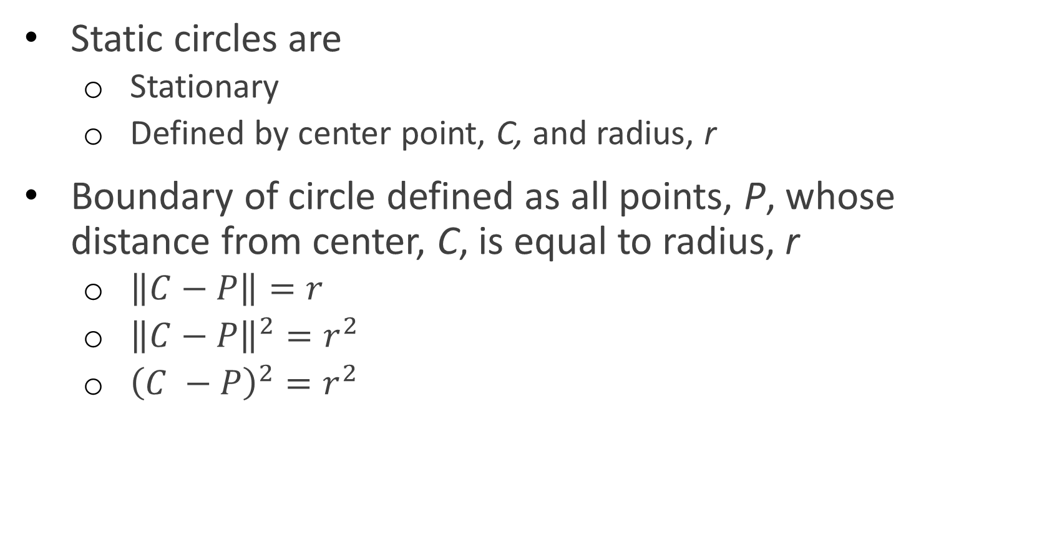
Static Circles
Static circles are
Stationary
Defined by center point, C, and radius, r
Boundary of circle defined as all points, P, whose distance from center, C, is equal to radius, r
$\left\|C−P\right\|=r$
${\left\|C−P\right\|}^{2}=r^{2}$
${\left(C −P\right)}^{2}=r^{2}$

Slide 4
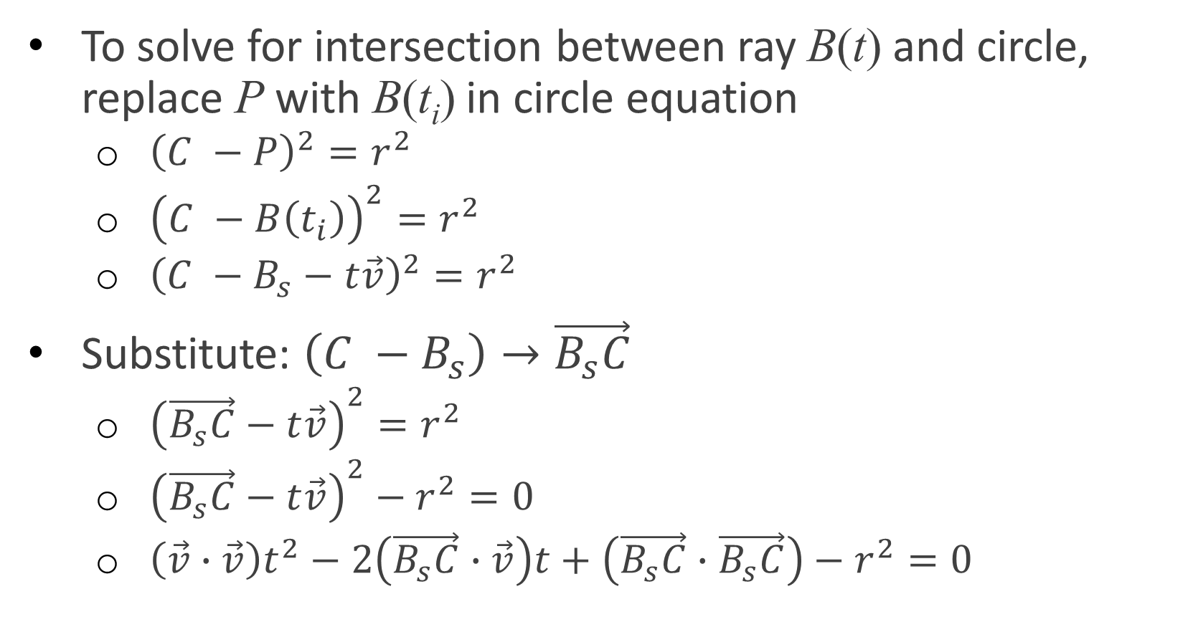
Ray–Circle Collision
To solve for intersection between ray B(t) and circle, replace P with B(t_{i}) in circle equation
${\left(C −P\right)}^{2}=r^{2}$
${\left(C −B\left(t_{i}\right)\right)}^{2}=r^{2}$
${\left(C −B_{s}−t\vec{v}\right)}^{2}=r^{2}$
Substitute: $\left(C −B_{s}\right)→\vec{B_{s}C}$
${\left(\vec{B_{s}C}−t\vec{v}\right)}^{2}=r^{2}$
${\left(\vec{B_{s}C}−t\vec{v}\right)}^{2}−r^{2}=0$
$\left(\vec{v}∙\vec{v}\right)t^{2}−2\left(\vec{B_{s}C}∙\vec{v}\right)t+\left(\vec{B_{s}C}∙\vec{B_{s}C}\right)−r^{2}=0$

Slide 5
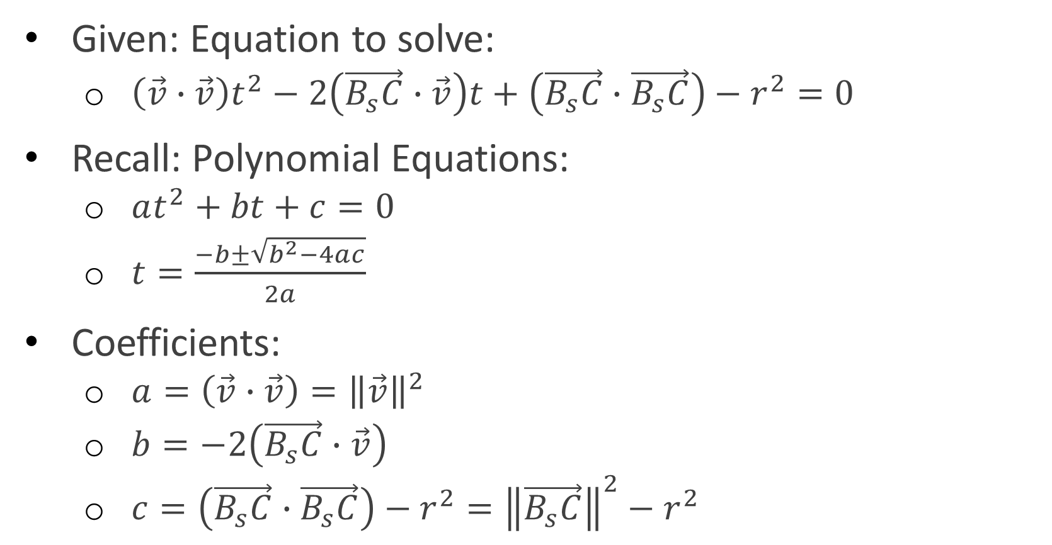
Ray–Circle Collision
Given: Equation to solve:
$\left(\vec{v}∙\vec{v}\right)t^{2}−2\left(\vec{B_{s}C}∙\vec{v}\right)t+\left(\vec{B_{s}C}∙\vec{B_{s}C}\right)−r^{2}=0$
Recall: Polynomial Equations:
$at^{2}+bt+c=0$
$t=\frac{−b±\sqrt{b^{2}−4ac}}{2a}$
Coefficients:
$a=\left(\vec{v}∙\vec{v}\right)={\left\|\vec{v}\right\|}^{2}$
$b=−2\left(\vec{B_{s}C}∙\vec{v}\right)$
$c=\left(\vec{B_{s}C}∙\vec{B_{s}C}\right)−r^{2}={\left\|\vec{B_{s}C}\right\|}^{2}−r^{2}$

Slide 6

Ray–Circle Collision
To solve for t:
$t=\frac{−b±\sqrt{b^{2}−4ac}}{2a}$
Where:
$a={\left\|\vec{v}\right\|}^{2}$
$b=−2\left(\vec{B_{s}C}∙\vec{v}\right)$
$c={\left\|\vec{B_{s}C}\right\|}^{2}−r^{2}$

Slide 7
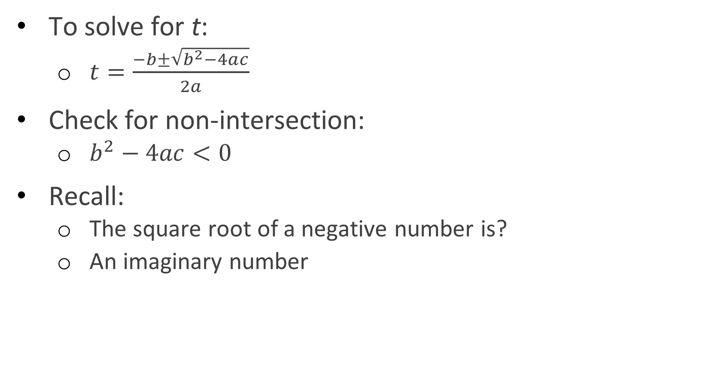
Ray–Circle Collision
To solve for t:
$t=\frac{−b±\sqrt{b^{2}−4ac}}{2a}$
Check for non-intersection:
$b^{2}−4ac<0$
Recall:
The square root of a negative number is?
An imaginary number

Slide 8
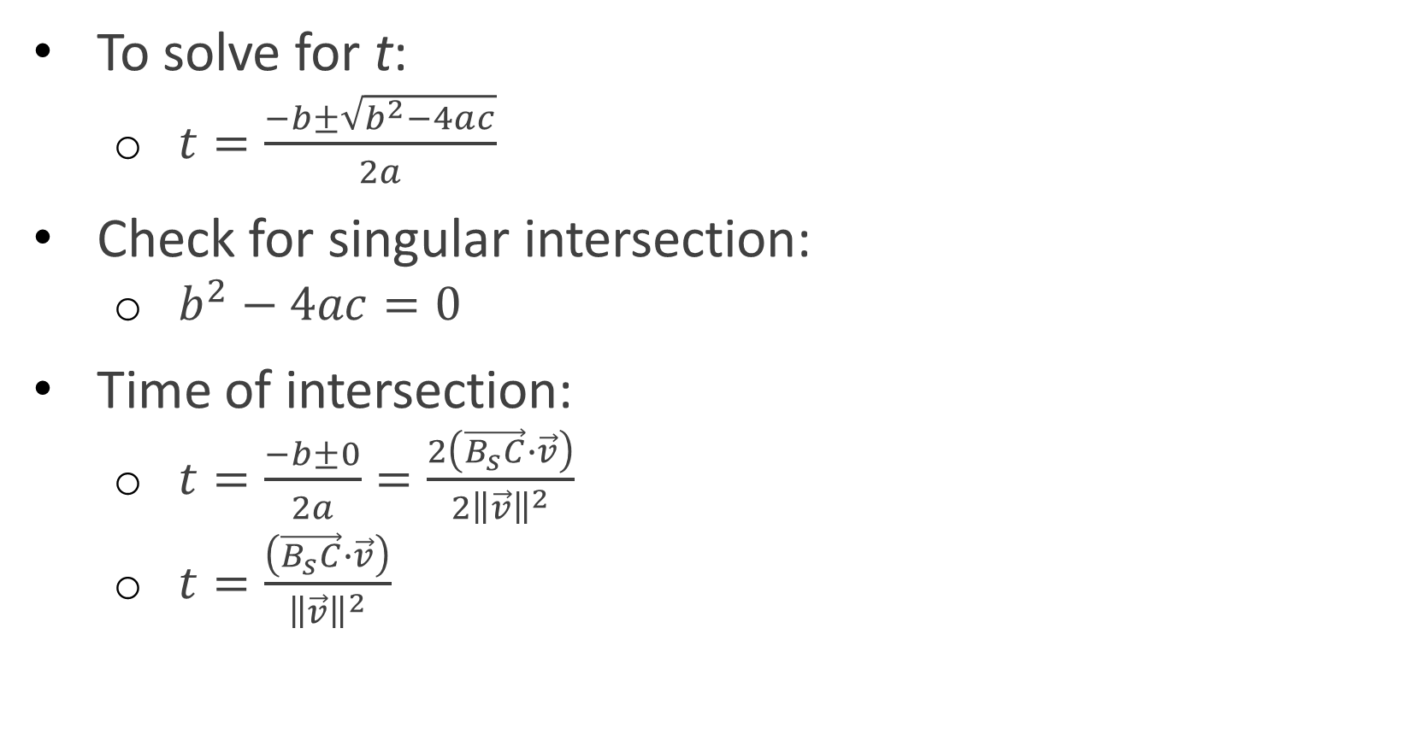
Ray–Circle Collision
To solve for t:
$t=\frac{−b±\sqrt{b^{2}−4ac}}{2a}$
Check for singular intersection:
$b^{2}−4ac=0$
Time of intersection:
$t=\frac{−b±0}{2a}=\frac{2\left(\vec{B_{s}C}∙\vec{v}\right)}{2{\left\|\vec{v}\right\|}^{2}}$
$t=\frac{\left(\vec{B_{s}C}∙\vec{v}\right)}{{\left\|\vec{v}\right\|}^{2}}$

Slide 9
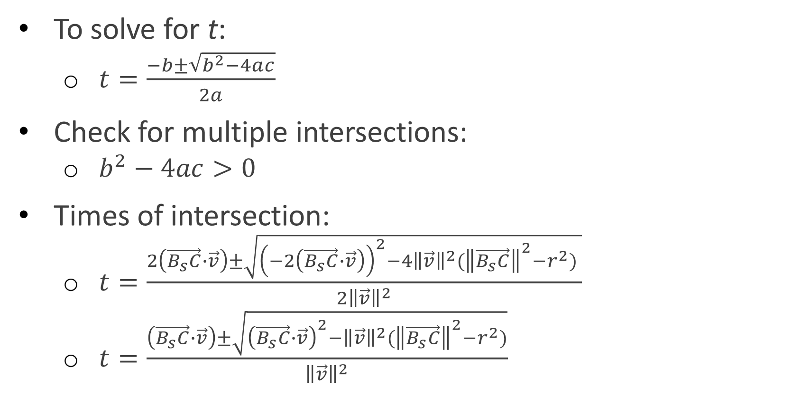
Ray–Circle Collision
To solve for t:
$t=\frac{−b±\sqrt{b^{2}−4ac}}{2a}$
Check for multiple intersections:
$b^{2}−4ac>0$
Times of intersection:
$t=\frac{2\left(\vec{B_{s}C}∙\vec{v}\right)±\sqrt{{\left(−2\left(\vec{B_{s}C}∙\vec{v}\right)\right)}^{2}−4{\left\|\vec{v}\right\|}^{2}({\left\|\vec{B_{s}C}\right\|}^{2}−r^{2}) }}{2{\left\|\vec{v}\right\|}^{2}}$
$t=\frac{\left(\vec{B_{s}C}∙\vec{v}\right)±\sqrt{{\left(\vec{B_{s}C}∙\vec{v}\right)}^{2}−{\left\|\vec{v}\right\|}^{2}({\left\|\vec{B_{s}C}\right\|}^{2}−r^{2})}}{{\left\|\vec{v}\right\|}^{2}}$

Slide 10
Questions?

Slide 11
Ray-Circle Collision (Part II)
The Vector Math solution

Slide 12
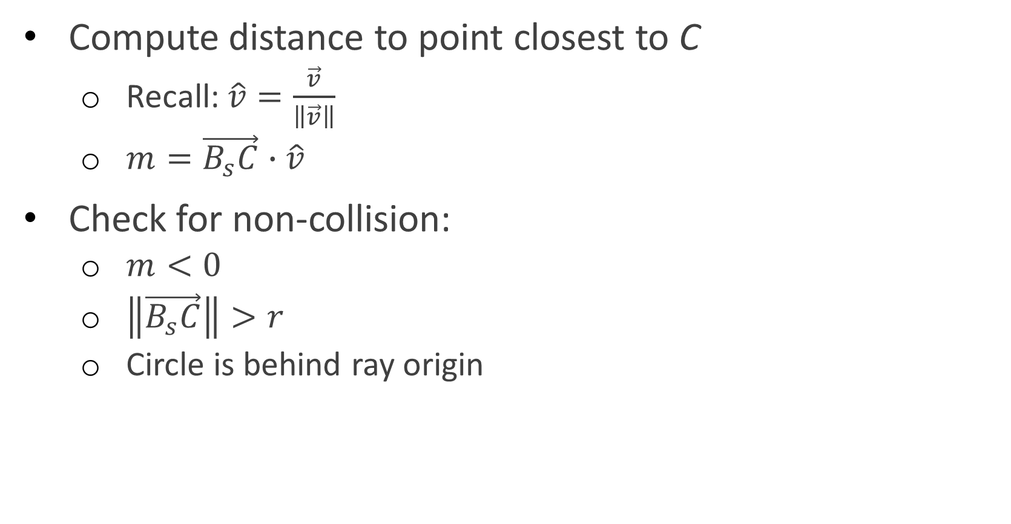
Ray–Circle Collision (2nd Method)
Compute distance to point closest to C
Recall: $\hat{v}=\frac{\vec{v}}{\left\|\vec{v}\right\|}$
$m=\vec{B_{s}C}∙\hat{v}$
Check for non-collision:
$m<0$
$\left\|\vec{B_{s}C}\right\|>r$
Circle is behind ray origin

Slide 13
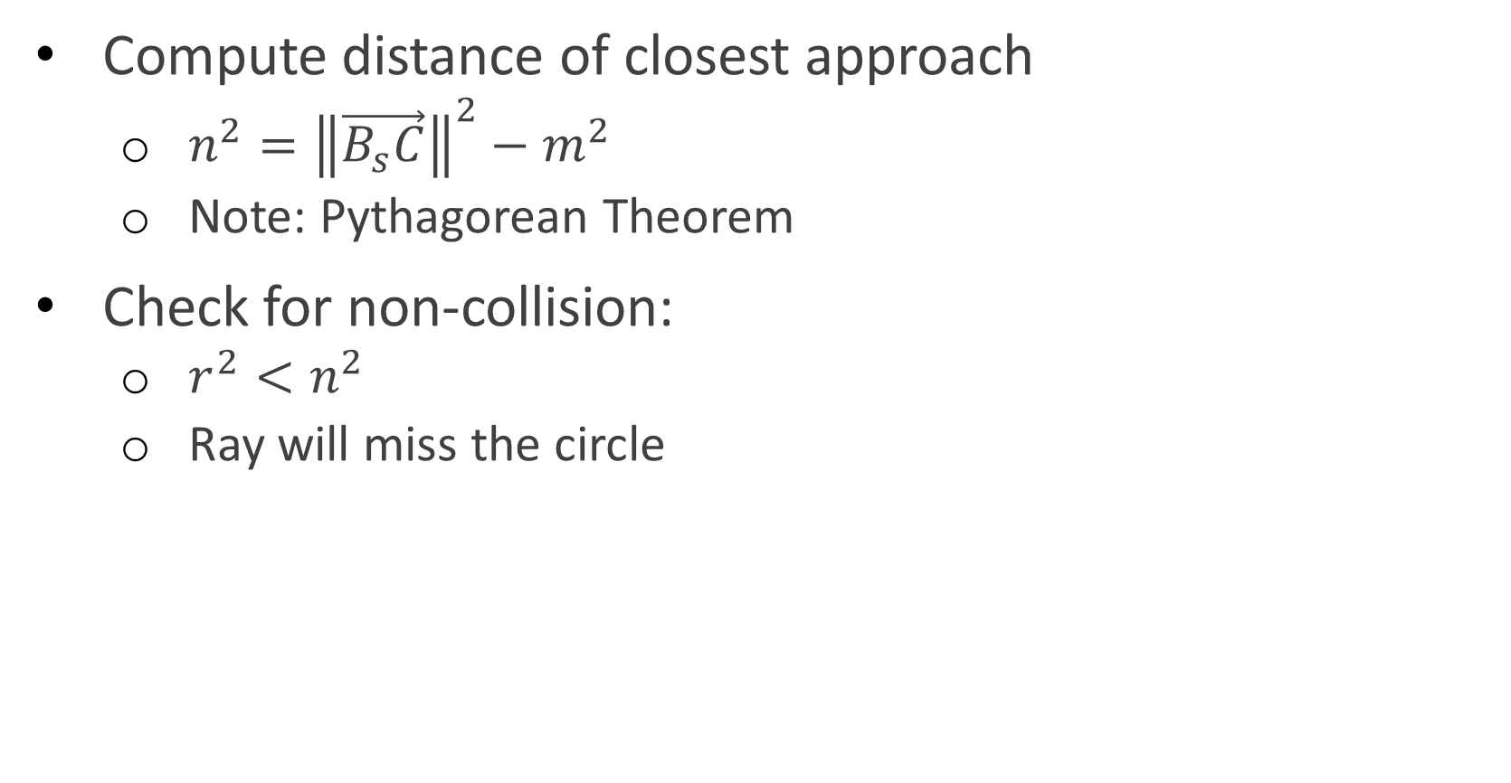
Ray–Circle Collision (2nd Method)
Compute distance of closest approach
$n^{2}={\left\|\vec{B_{s}C}\right\|}^{2}−m^{2}$
Note: Pythagorean Theorem
Check for non-collision:
$r^{2}<n^{2}$
Ray will miss the circle

Slide 14
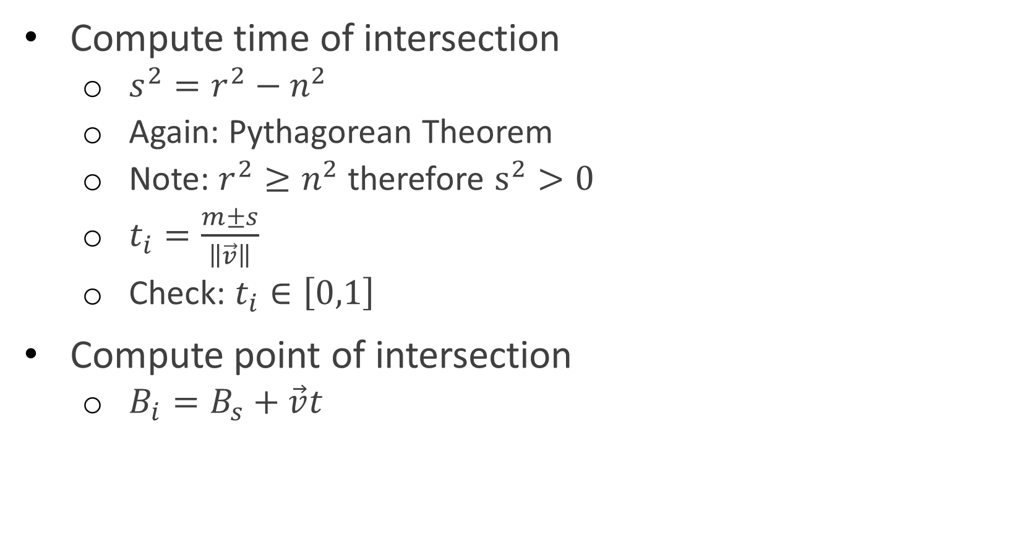
Ray–Circle Collision (2nd Method)
Compute time of intersection
$s^{2}=r^{2}−n^{2}$
Again: Pythagorean Theorem
Note: $r^{2}≥n^{2}$ therefore $s^{2}>0$
$t_{i}=\frac{m±s}{\left\|\vec{v}\right\|}$
Check: $t_{i}∈\left[0,1\right]$
Compute point of intersection
$B_{i}=B_{s}+\vec{v}t$

Slide 15
Questions?

Slide 16
Circle-Static Circle Collision

Slide 17
Circle–Static Circle Collision
Dynamic circle defined by center B_{s} and radius r_{s}
Static circle defined by center point C and radius r_{c}

Slide 18
Circle–Static Circle Collision
Similar to intersection tests between ray from B_{s} to B_{e} and circle of radius (r_{s}+r_{c})

Slide 19
Ray-Circle Reflection

Slide 20

Ray–Circle Reflection
Compute point of intersection
$\vec{v}=B_{e}−B_{s}$
$B_{i}=B_{s}+\vec{v}t_{i}$
Compute collision normal
$\vec{n}=\vec{CB_{i}}$
$\hat{n}=\frac{\vec{n}}{\left\|\vec{n}\right\|}$

Slide 21

Ray–Circle Reflection
Compute reflection vector
$\vec{m}=\vec{B_{i}B_{s}}=B_{s}−B_{i}$
$\vec{u}+\vec{s}=\vec{m}$
$\vec{u}−\vec{s}=\vec{r}$
$2\vec{u}=\vec{m}+\vec{r}$
$\vec{r}=2\vec{u}−\vec{m}$
$\vec{u}=\left(\vec{m}∙\hat{n}\right)\hat{n}$
$\vec{r}=2\left(\vec{m}∙\hat{n}\right)\hat{n}−\vec{m}$

Slide 22
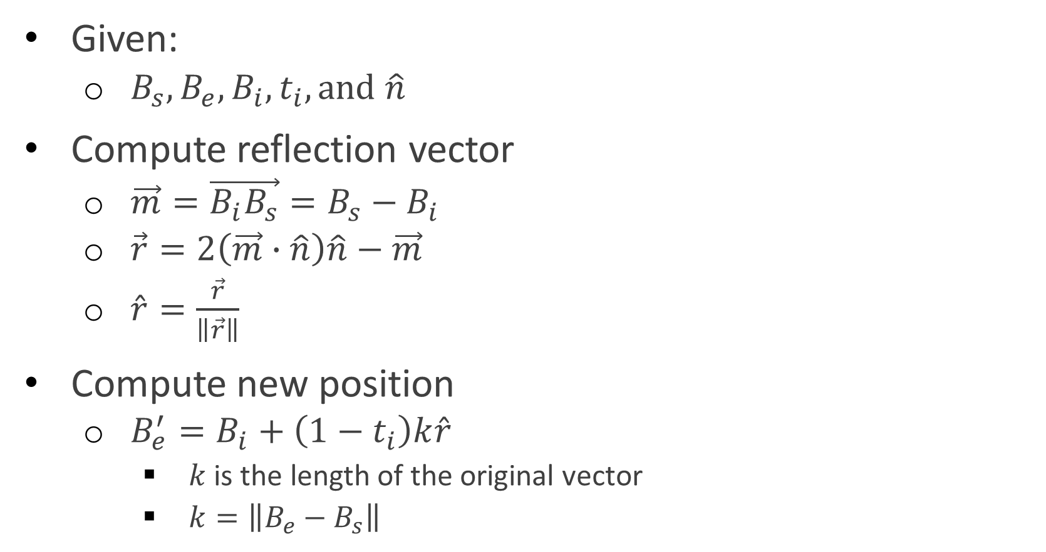
Ray–Circle Reflection
Given:
$B_{s},B_{e},B_{i}, t_{i}, and \hat{n}$
Compute reflection vector
$\vec{m}=\vec{B_{i}B_{s}}=B_{s}−B_{i}$
$\vec{r}=2\left(\vec{m}∙\hat{n}\right)\hat{n}−\vec{m}$
$\hat{r}=\frac{\vec{r}}{\left\|\vec{r}\right\|}$
Compute new position
$B_{e}^{′}=B_{i}+\left(1−t_{i}\right)k\hat{r}$
$k$ is the length of the original vector
$k=\left\|B_{e}−B_{s}\right\|$

Slide 23
Questions?

